Slide 1
Phase 1
IDENTIFY
Notes:
Review the previous weeks assignment for 20 – 30 mins before beginning the presentation. This week is to make the students learn about identifying needs and define a problem statement.
This presentation has many images with puzzles. Some students may be knowing the answers earlier. Hence, give time for the whole class to think, and only after that make them answer.

Slide 2
Notes:
Ask them to write down this statement on the table in straight line. Ask them to read it loud. Ask them to find the Extra “the” that they might have missed.

Slide 3
FINISHED FILES ARE THE RE
SULT OF YEARS OF SCIENTI
FIC STUDY COMBINED WITH
THE EXPERIENCE OF YEARS.
Notes:
Ask the students to count how many “f” are there in the image. If they answer less than 6, ask them to count again, till they get 6

Slide 4
Notes:
Now increase the level. Ask the students to identify what’s wrong in this image. Do not ask them to answer loud. Some students might be knowing the answers already. Just ask them to lift their hands. Give time for the whole class to think. If still they are not able to find, ask them to find where is the seat in the bench.

Slide 5
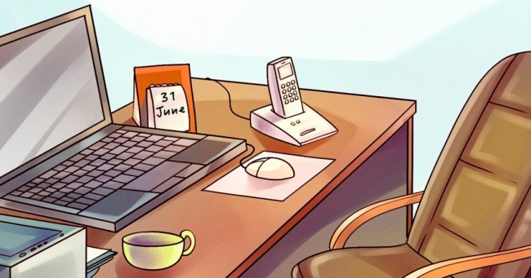
Notes:
Ask the students to identify what’s wrong in this image. Just ask them to lift their hands. Give time for the whole class to think.
Apart from the missing space bar, the big mistake is, June has only thirty days.

Slide 6
Notes:
Ask the students to identify what’s wrong in this image. Just ask them to lift their hands. Give time for the whole class to think. The fourth model from top has both feet of right leg

Slide 7
Notes:
What's wrong in the picture. Reflection of the arms is not mirrored.

Slide 8
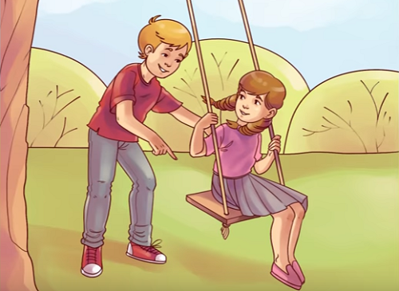
Notes:
What’s wrong in the picture. The rope is not tied to the centre of the board
Now ask the students, what was their learning from this activity? What did they do to solve the puzzles?

Slide 9
OBSERVATION
Details in surroundings
Understanding about the scene
Data required for doing any project
Recording tools – Photo, video, audio, notes, doodles
Note:
All details are important.
No detail should be ignored considering as insignificant and tiny
Notes:
Make the students to take notes on the following information.
You identified the flaws in the images based on observation. Always look for details in the surroundings. The details are the data required for doing any project.
It is very important for a designer/ engineer to have a sense of observation. Observing gives a huge understanding about the scene/ product/ event/ task. This understanding have to be recorded/documented for further analysis. It can be done by capturing photos, recording video/audio, documenting on notepads and so on. Quick doodles can improve the documentation process.
Any kind of detail is important. No detail should be considered as small or insignificant and should not be ignored,
Never assume any data. Always have evidence for the data.
Let’s see few more riddles before getting into next section
Don’t be judgemental.

Slide 10
Notes:
There are some words written in this image. Identify the words and list out on a paper/white board. Time: One minute

Slide 11
Notes:
Identify the words and list out on a paper. One minute.

Slide 12
Notes:
Identify the words and list out on a paper. One minute.

Slide 13
Notes:
Identify the words and list out on a paper. One minute.

Slide 14
Notes:
The words are Garden, Bloom, Dig, Vine, Seed, Farm

Slide 15
Notes:
Mirror, Couch, Straw, Tiles, Cat, Cord

Slide 16
Notes:
Book, Story, Words, Page, Novel, Read

Slide 17
Notes:
Frost, Mittens, Ice, Snow, Chill, Boot
Hope you started observing the things. Now lets get into actual scenario. Real time photographs.

Slide 18
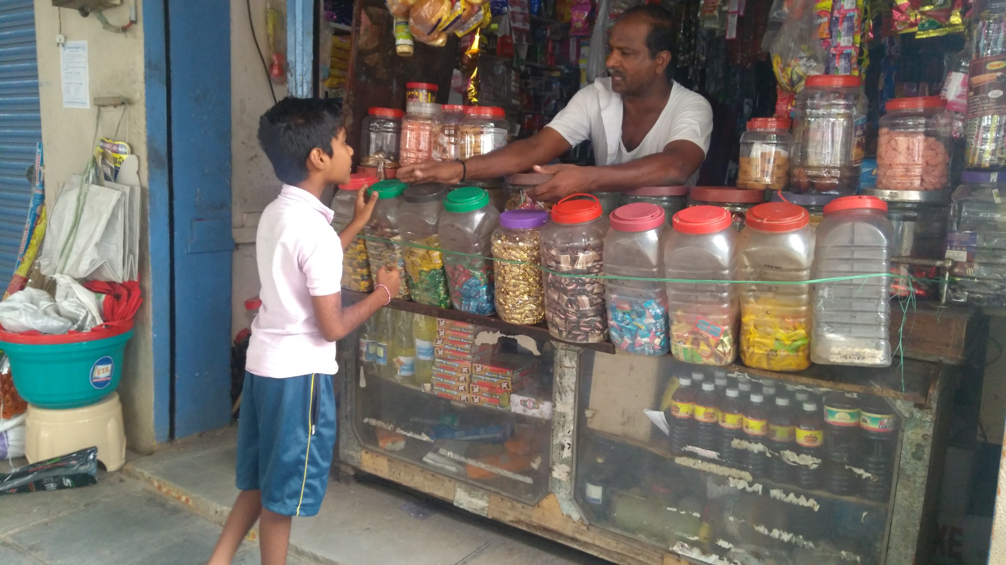
Notes:
1. Identify what are the elements/things in this image.
2. What is the Task/action happening here?
3. Try to identify the user here
4. What are the problems here? Only problems, not solutions
Time: 5 minutes
After 5 mins ask the students to read out the answers. Justify/ correct their answers and help them observe better.
Elements are the objects such as display unit, hanging items, glass jars, food products, space, shutter groove etc.
Action – shopping, Querying and answering, Buying and selling.
Shopkeeper is the user since he is using the elements in the shop. The little boy is a customer. The food products are used by boy, but only after purchasing. Till then shopkeeper is the user in this scenario.
Now ask about the problems. Once they have answered then move to the next slide and elaborate

Slide 19
PROBLEMS
Difficult to perform
Causes physical injury
Repetitive task
Stressful
Uncomfortable
Complicated
Confusing
Unorganized etc.,
Note:
Problems vary from person to person and differs with respect to context
Notes:
Make the students to take notes on the following information.
Problems as per design terms are something that is (mentioned above) while performing any task or happening in any place.
Since, problems are not common to all, only after verifying from multiple users it has to be documented as problem.
Eg. In the previous shopkeeper problems, we need to observe many shopkeepers and then only we should conclude stating that it is a problem. Same for any observation.
Lets see some more scenarios and try the same.

Slide 20
Notes:
1. Identify what are the elements/things in this image.
2. What is the Task/action happening here?
3. Try to identify the user here
4. What are the problems here? Only problems, not solutions

Slide 21
Notes:
1. Identify what are the elements/things in this image.
2. What is the Task/action happening here?
3. Try to identify the user here
4. What are the problems here? Only problems, not solutions
By now students should be able to observe and interpret images. They should be able to present understanding from the images.

Slide 22
Phase 2
DEFINE
Notes:
Problem needs to be defined in this phase. The students are to be informed that they will be selecting a place to visit with their groups and do what they have learnt until now – Identifying problems in a given scenario.

Slide 23
INFORMATION
Details of the Visit
Place - Users - Tasks - Tools - Pains
Notes:
The students need to identify pain points by previously mentioned method.
After visiting the place, the students must be able to identify different users interacting with the place,
They should be able to identify the tasks and sub tasks that each user performs.
They should be able to understand and identify the tools being used to perform the task / sub task.
All the team members are advised to capture as many photos as possible for this task flow analysis.
Task flow should be analysed for any kind of pain, in detail.
No detail should be considered as small or insignificant and should not be ignored,
Never assume any data. Always have evidence for the data.

Slide 24
Place | Users | Tasks / Sub tasks | Tools | Pains
 | Old / Aged Joggers | Tasks: Run Laugh Yoga Sub task: Socialize Rest | Shoes Yoga Mat Step Counter Benches | Yoga Mat – Extra Luggage Benches – Not comfortable for old people to rest
Public Garden | Security | Task: Guard Help | Lathi Cabin Chair
 | Maintenance | Cut trees Clean Water | Shears Broom Stick Water Pipe
 | Pregnant Woman / Lactating Mothers | Task: Yoga Meditate Sub task: Rest Socialise. Care for Children | Yoga Mat Water bottle | Water bottle – Not easy to carry as an extra weight. No privacy for breast feeding when the child demands
Notes:
Make the students to write down the information collected in the described format.

Slide 25
PAIN STORMING
Prioritization
Pains / Problems - Severe - Moderate - Mild
Notes:
Prioritize the pain points based on severity / requirement

Slide 26
Pains | Users | Severe | Moderate | Mild
Yoga Mat – Extra Luggage | Joggers
Benches – Not comfortable for old people to rest | Joggers
No privacy for breast feeding when the child demands | Pregnant Woman / Lactating Mothers
Water bottle – Not easy to carry as an extra weight. | Pregnant Woman / Lactating Mothers
Notes:
After Prioritization of the pain points / problems, they need to sort out the information in the described format.

Slide 27
PAIN STORMING
Prioritization
Problem Statement: The User is facing Pain Point while working with Tool to perform the Task / Sub task in the Place
Notes:
Mentors are advised to make sure that the student’s Problem Statement is finalized by the end of the class in the abovementioned format.

Slide 28
Review
Good Design & Bad Design
Identify – Problems & Pain Points as opportunities
Painstorming - Identifying Problems / Pain Points
Need / Problem Prioritization
Problem Statement
Notes:
Review the activities in the class.

Slide 29
Assignment 2 Marks: 6
Collect information, capture photographs, comment on each activity and send the same to the leader, who will add his / her work and make a Power Point Presentation on the team’s place of visit and Pain point prioritization, in the shared format.
Notes:
Share ‘PDS - Assignment - 2 - Place Of Visit & Pain Point Prioritization – Template.pptx’ to the WhatsApp group.

